Slide 1
Theme 1. Basics of Digital Signal Processing

Slide 2

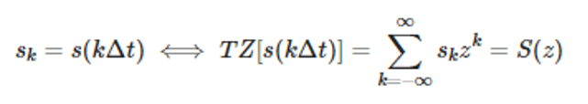



Most common signal representation - Z-transform
Arbitrary continuous function s(t), which is evenly discretized as , so as discrete function, can be put in in accordance with z-polynomial with consecutive coefficients s_{k} :
where - arbitrary complex variable.
In exponential form , where

Slide 3
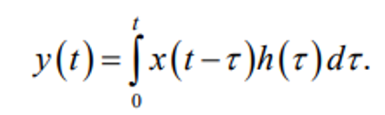



Linear discrete filters, difference equations
Linear filter h(t), input signal x(t), t>=0, then filter’s response:
Discrete filter - discrete convolution:
We can define filter’s response as function of current tick x(k) and some previous input and output ticks:
- recursive filter. Only input ticks - non-recursive
x(k), y(k), a_{m}, b_{m} are quantized - digital filter
As z-representation - (z^{-m} - sequence delay by m ticks)

Slide 4
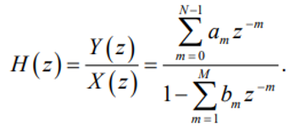




Transfer and impulse functions of digital filter
TL;DR - transfer function is the output divided by input, impulse function - the reaction to delta-impulse (singular impulse)
Transfer function H(z): if k=0
Impulse function h(k): (can be derived from filter’s linearity and from the fact, that z-representation of delta-impulse equals 1 on whole z plane)
In zero state response of filter with impulse function h(k) can be derived with linear convolution
Stability condition (for limited input signal output stays limited) -
if k!=0

Slide 5


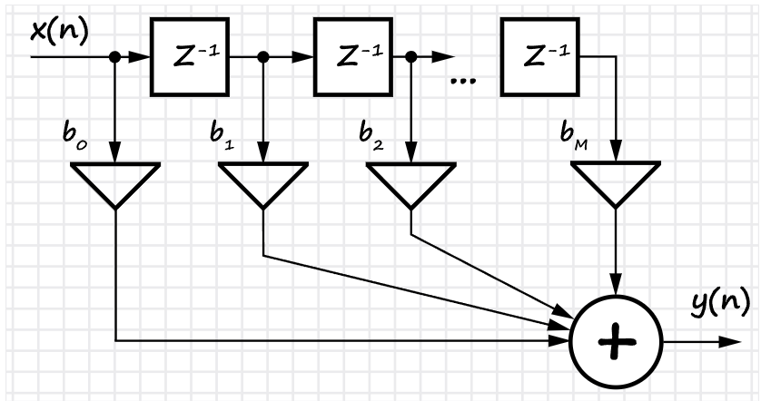
FIR and IIR filters
TL;DR - FIR filter has limited number of coefficients, IIR filter has unlimited number of coefficients
Finite impulse response filter:
impulse function is limited in time (finite number of coefficients)
reaction to delta-impulse - finite number of ticks
non-recursive
difference equation
transfer function

Slide 6


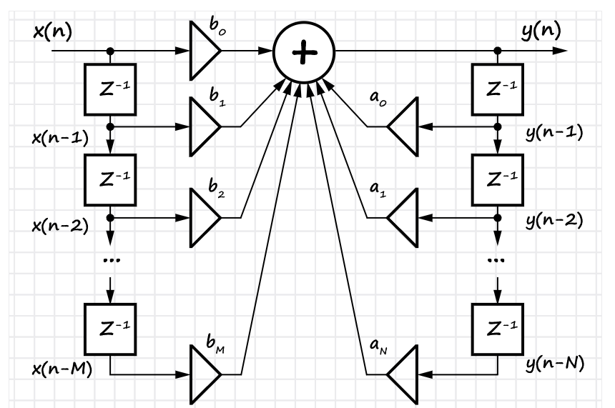
FIR and IIR filters
TL;DR - FIR filter has limited number of coefficients, IIR filter has unlimited number of coefficients
Infinite impulse response filter:
impulse response is unlimited in time (infinite number of coefficients)
recursive (output signal is sent back to input)
difference equation
transfer function
Can be unstable; output signal can generate its own oscillations
a

Slide 7
FIR and IIR filters: how to choose?
FIR filters have linear phase - these filters doesn’t distort the form of the signal
FIR filters are stable (non-recursive) - IIR filter could be unstable
Tasks on choosing data bit depth (rounding, quantization) have less impact on hardware without feedback
Frequency responses of complex shape require great number of filter coefficients - IIR filters is more suitable for that case
FIR filters don’t have equivalent analogue filters
FIR filters make it easy to get the desired characteristics (attenuation level, passband ripple, cutoff frequency, etc.)
IIR filters are much more economical in terms of the number of operations: multiplications, additions, and the number of delay lines.

Slide 8
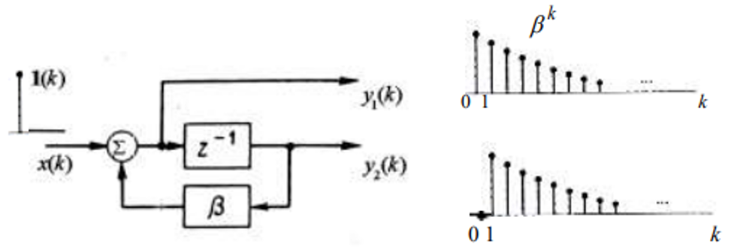
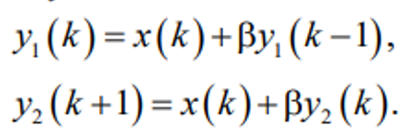

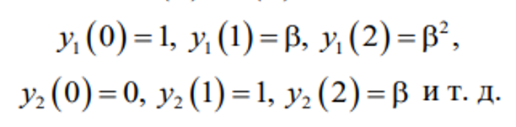
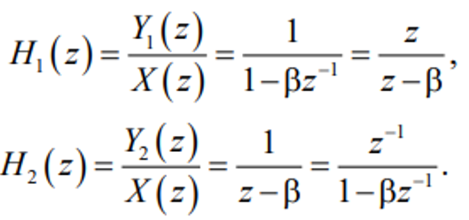
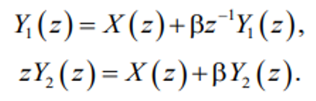
FIR and IIR filters: examples
Discrete adder
difference equations:
Let :
Transfer functions can be derived as
unit impulse is circulating with delay Δt and multiplying by β each cycle - outputs create oscillations with infinite duration - IIR filter

Slide 9
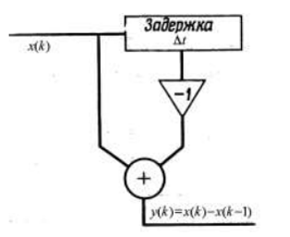






FIR and IIR filters: examples
Discrete differentiator
The only information about signal - its values at discrete moments:
Let Δt=1 - difference equation:
Transfer function:
Let then So impulse function will be it’s the common example of FIR filter
Delay

Slide 10

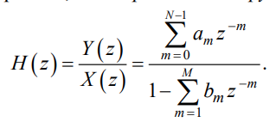


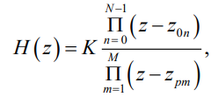
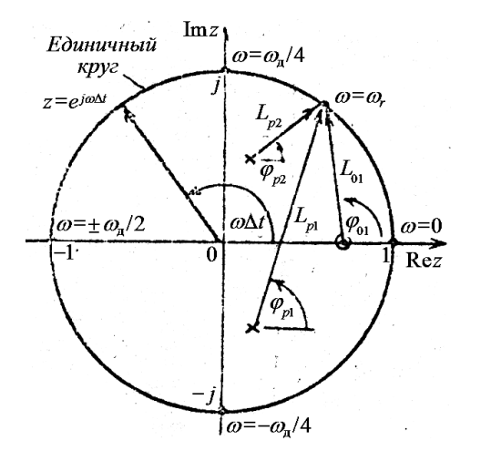



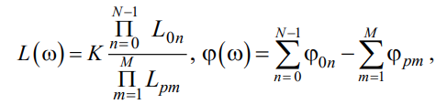


Frequency responses, zeros and poles
If every b_{m}= 0:
Filter output depends only on input ticks, a_{m} - ticks of impulse function (h(m)) - FIR filter (h(m) is finite). If any of b_{m}!=0 - IIR filter
K - gain, z_{0n} - zeros, z_{pn} - poles. Let :
To define amplitude-frequency and phase-frequency responses we’ll take a look at unit circle in z-plane. Here we have two poles and one zero. By definition, Amplitude-frequency response is and phase-frequency response is
Notes:
http://kprf.mipt.ru/attachments/article/68/%D0%BB%D0%B5%D0%BA%D1%86%D0%B8%D1%8F_17_%D1%84%D0%B5%D0%B2%D1%80%D0%B0%D0%BB%D1%8F_2020.pdf

Slide 11
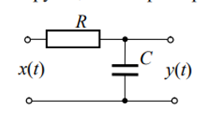





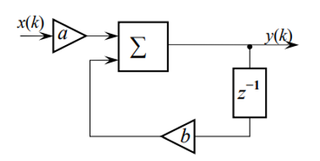



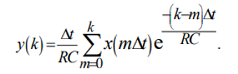




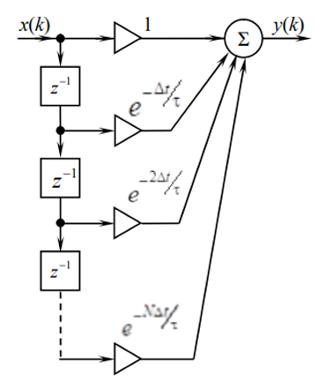

Back to examples: RC-lowpass filter
This difference equation set recursive digital filter:
For analogue filter:
Then
If we limit this function to N terms (because each term is decreasing exponentially and all after N will be insignificant), we can construct non-recursive filter:

Slide 12



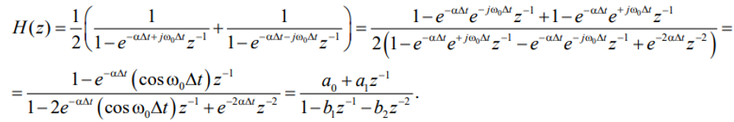
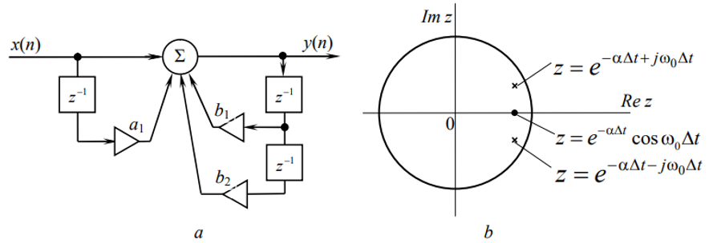
Digital equivalent of oscillatory circuit
Impulse function of oscillatory circuit -
Drop A, :
Transfer function:
Difference equation:

Slide 13
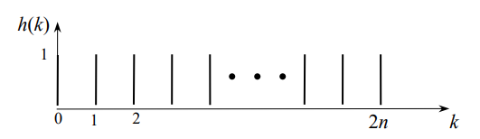



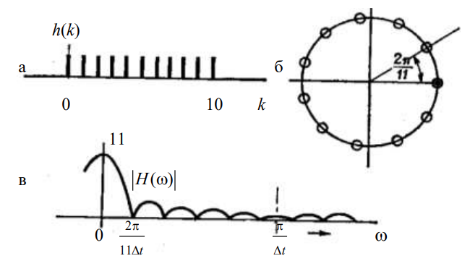
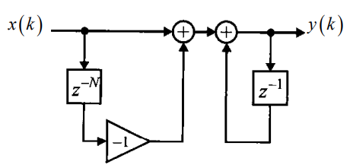
Recursive [range]-pass filters
All of them are based on the idea of Moving Average filters:
transfer function:
It has 2n+1 equally distributed on unit circle zeros and single pole at z=1. Difference equation becomes . Let n=5, then

Slide 14

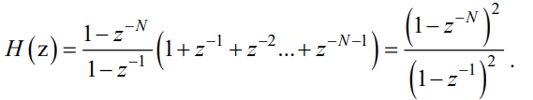

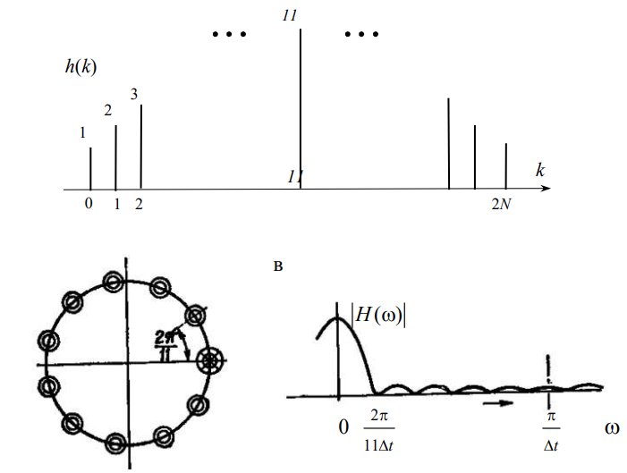
Recursive [range]-pass filters
We can suppress sidelobes of , if we increase the order of zeros and poles of H(z). Let’s take a look at triangular impulse function of 2N+1 length (sum of shifted sequences of unit ticks):
It has N 2nd order equally distributed zeros and 2nd order pole at z=1. For N=11:
It’s the same as previous one, but all zeros and poles are 2nd order now,
and it’s the square of previous transfer function
IMPORTANT:
Equal distribution of zeros on unit circle with following elimination of one or several of them with poles leads to recursive filters with integer coefficients and linear phase functions. Moreover, we can raise given transfer function to integer power to suppress sidelobes and increase the slope

Slide 15
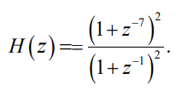
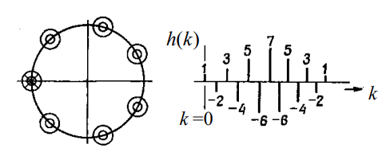

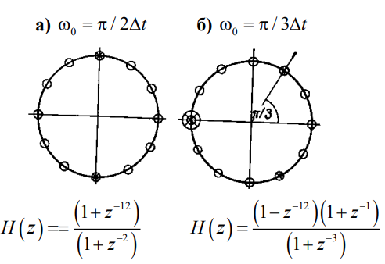
Recursive [range]-pass filters
Equal distribution of zeros on unit circle with following elimination of one of them with pole at z=-1 leads to high-pass filters. Let
Difference equation
If we instead eliminate zero at z=+-j, this will lead to band-pass filter with peak at

Slide 16



Discrete Fourier Transform
x(n) -> X(k):
N is the number of decomposition components, the number of signal values measured over the period;
n is the tick number of the sampled signal, n = 0, 1, ... , N–1;
k is the harmonic number of the transformation component, and T is the period of time during which the input data were taken;
– twiddle factor
Here is spectral density (spectrum) of discrete sequence. For analogue signals sum becomes an integral.
It takes N operations of complex multiplication and addition to calculate one spectral sample. Since there are N such operations, the total computational complexity of the DFT is N².
X(k) -> x(n):
Because amplitudes of spectral samples are complex, we can calculate the amplitude AND the phase of the signal simultaneously

Slide 17
NAIL THIS AT THE HEAD OF THE BED
Kotelnikov–Nyquist–Shannon sampling theorem
If a system uniformly samples an analog signal at a rate that exceeds the signal’s highest frequency by at least a factor of two, the original analog signal can be perfectly recovered from the discrete values produced by sampling.
Because of that, DFT exactly corresponds to the continuous Fourier transform if the function being transformed is a function with a limited spectrum, while the sampling frequency F_{d} must be at least twice the maximum frequency of the spectrum F_{v}

Slide 18






Discrete Fourier Transform: properties
Spectral density of discrete signal is a periodic function with a period equal to the sampling rate
Linearity: the sum of the spectra of the signals is equal to the spectrum of the sum of the signals.
Shift by time: A cyclic shift of the signal by m counts leads to a rotation of the phase spectrum, while the amplitude spectrum does not change.
DFT of cyclic convolution of signals: for signal x(n), which is the result of cyclic convolution of two signals a(n) and b(n): N-point DFT of the sequence is:
DFT of the product of signals: for a signal x(n), which is the result of the product of two signals a(b) and b(n), the spectrum is:
Frequency shift: Similarly to the second property (time shift), if there is a spectrum X(k–m) shifted in frequency by m, then after the iDFT the sequence x(n) takes the following form:
Parseval's theorem: The average power of the discretized function of time is equal to the sum of the powers of the individual spectral components and does not depend on their phases:

Slide 19


Discrete Fourier Transform: twiddle factor
The coefficients of the DFT matrix or the twiddle factors W_{nk} can be found using the following formula:
Thus, the DFT matrix, without taking into account the normalizing factor, is structured as follows: the first row and column consist of 1, the second row contains roots of 1 of order n in natural order, the next rows are successive powers of the second row.

Slide 20
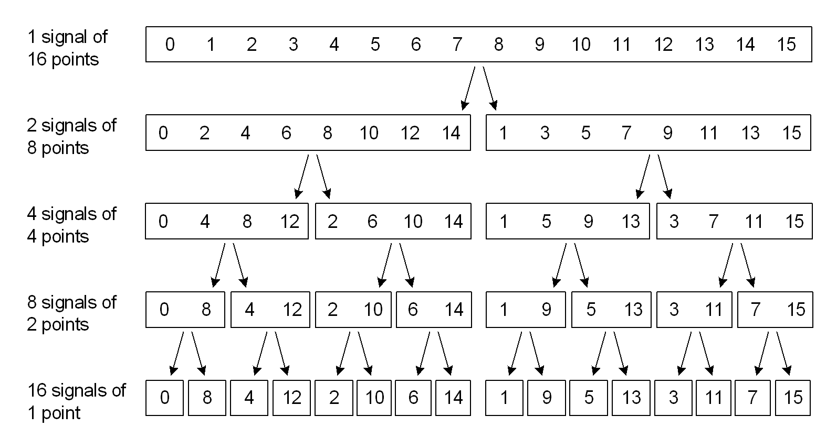
Discrete Fourier Transform to Fast Fourier Transform
TL;DR - split N-point sequence into parts, then calculate DFT for each part and linearly sum all of them
If the original sequence is divided into two equal parts of N/2 elements, then to perform the calculation of the transformation according to the classical formula at each stage, half the addition and multiplication operations will be required. And this reduction is applied in every division. For example, for N=8192 samples, the calculation of the DFT would require 67 million operations of complex addition and multiplication. Using FFT algorithms, you can reduce these numbers by factors of 1260 and 630 respectively.
FFT algorithms with sequence length N=2m, are called Base 2 FFT algorithms (Radix-2 FFT)

Slide 21



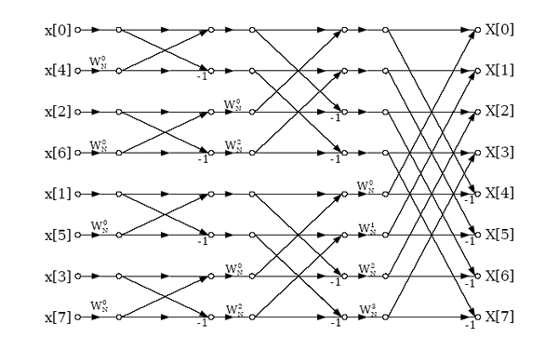
Radix-2 FFT: decimation in time and in frequency
There are two main methods for calculating the FFT in base 2 (Radix-2): with decimation in frequency (DIF) and in time (DIT)
DIT: split x(n) into two sequences with even ticks and off ticks:
binary-inverse permutation of the samples of the input signal, providing a partition of the original sequence;
do N/2 Butterfly operations to get the first union using rotation factors;
repeat the Butterfly operation to go to the next steps, also using the twiddle factors.
"Butterfly" is a directed graph, with which a pair of complex samples is calculated from the previous values. For a time-decimated FFT, the base-2 butterfly looks like:

Slide 22



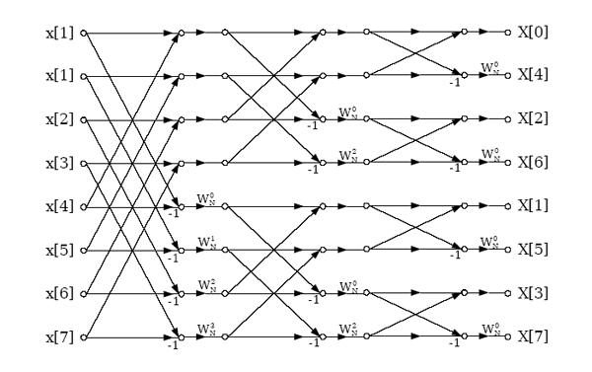
Radix-2 FFT: decimation in time and in frequency
DIF: split x(n) into two even sequences:
do N/2 Butterfly operations to get the first union using twiddle factors;
repeat the Butterfly operation to go to the next steps, also using the twiddle factors.
perform a binary-inverse permutation of the resulting signal;
For a frequency-decimated FFT, the base-2 butterfly looks like:

Slide 23
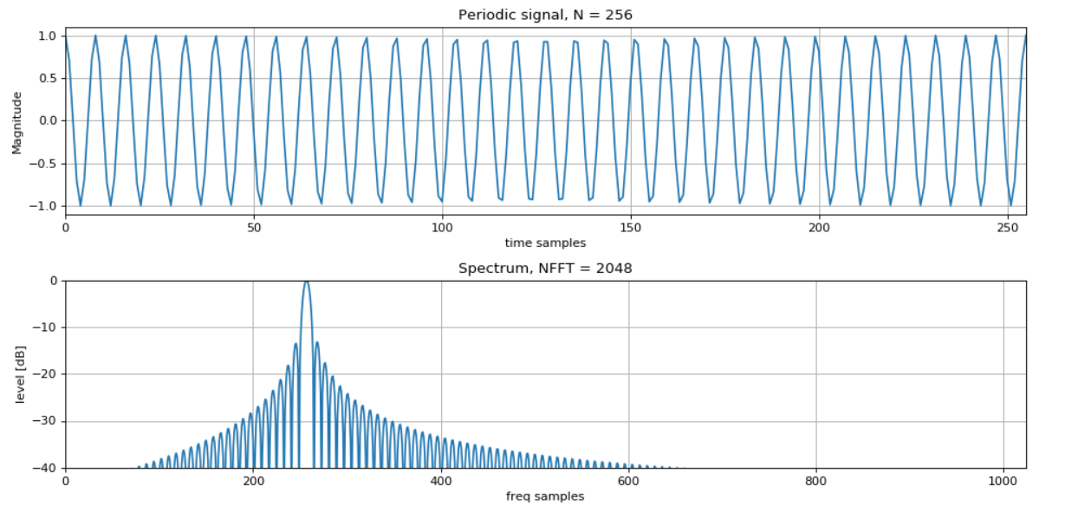
Windowing
TL;DR - we don’t have infinite signals in real life, so we have to work with limited in time signals. Windows help us to reduce the problems of such work.
Limited in time signal = convolution of infinite signal with rectangle window. This leads to imperfect “delta-functions”:
multiplication of signals in the time domain is the convolution of their spectra in the frequency domain (and vice versa: the convolution of signals in the time domain is the product of their spectra)
The longer the signal - the less the impact of “rectangle window”. Task - suppress the unnecessary sidelobes by using windowing.

Slide 24

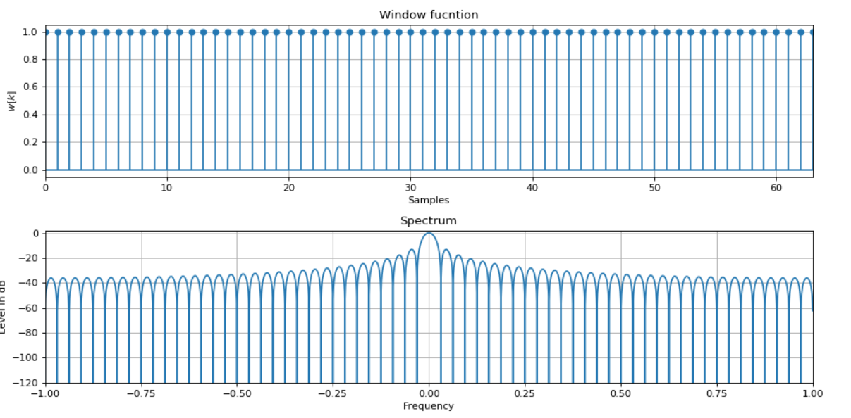
Windowing: most popular window functions
Rectangle window

Slide 25


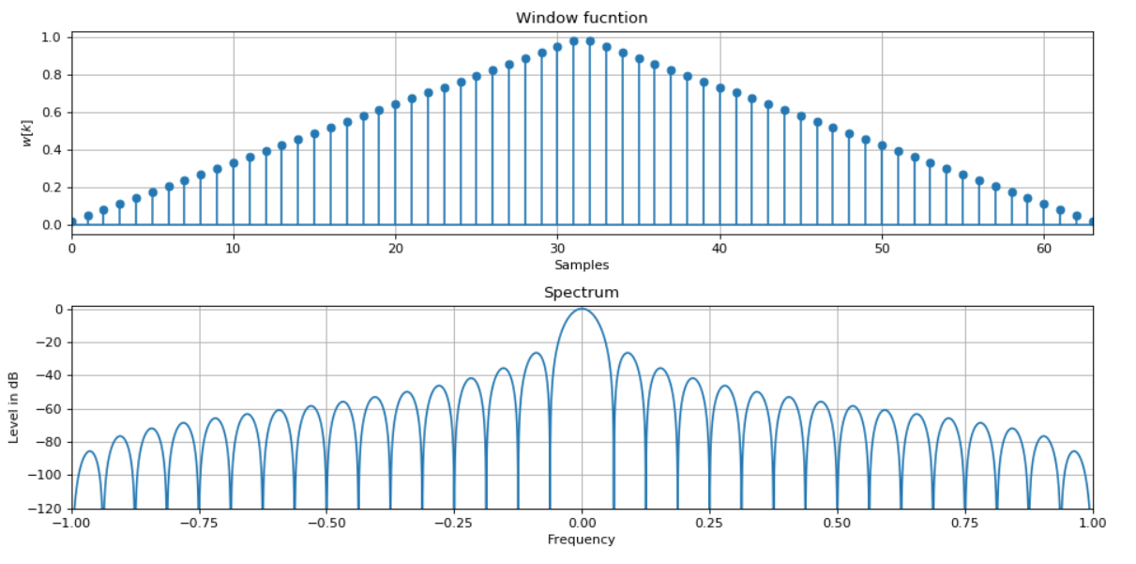
Windowing: most popular window functions
Triangle (Bartlett) window

Slide 26

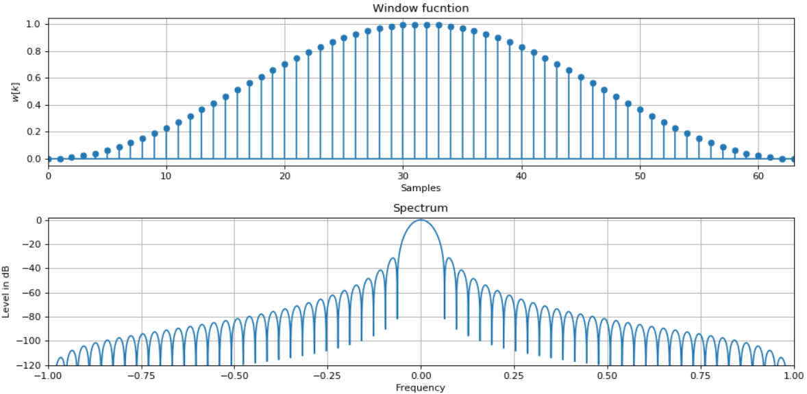
Windowing: most popular window functions
Hann window

Slide 27

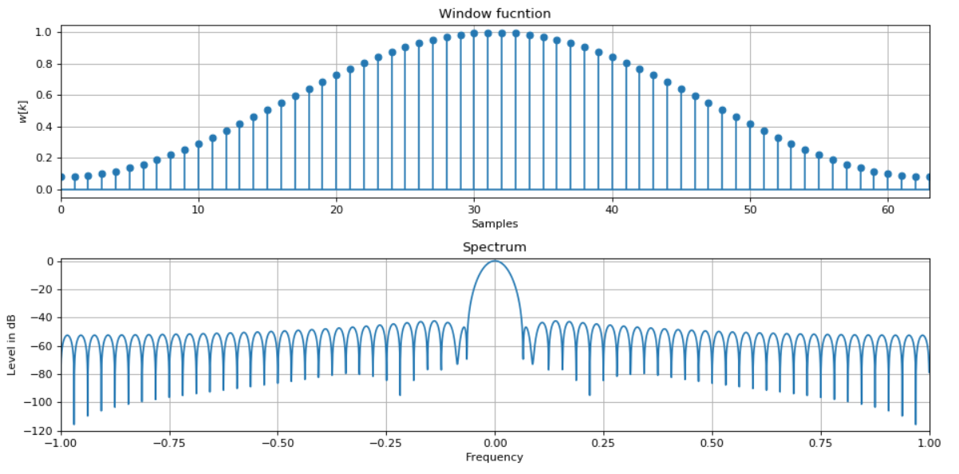
Windowing: most popular window functions
Hamming window

Slide 28


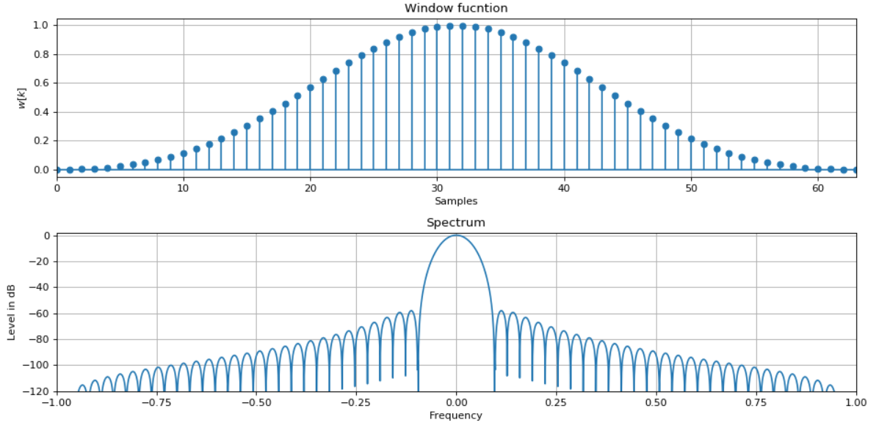
Windowing: most popular window functions
Blackman window

Slide 29

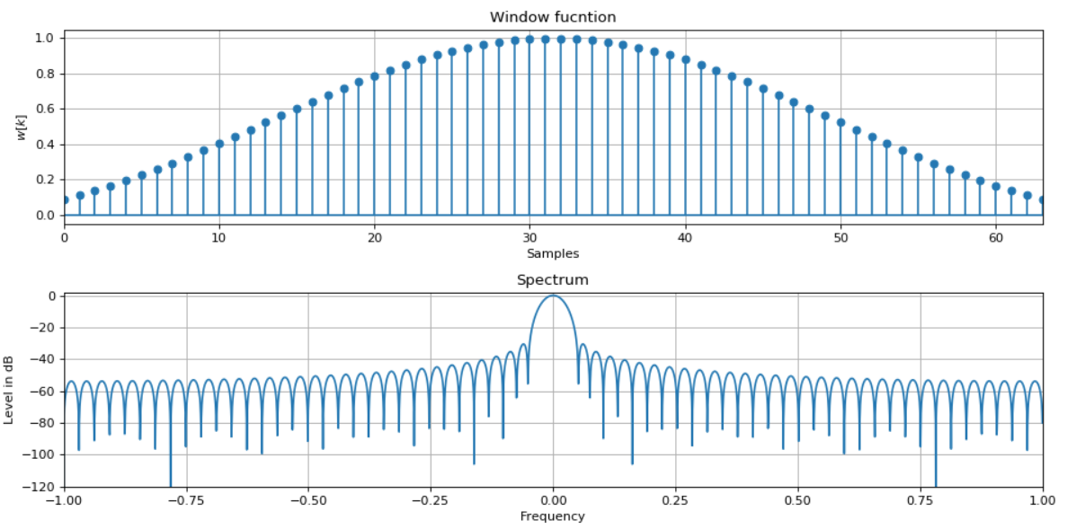
Windowing: most popular window functions
Kaiser window
Most flexible window because of parameter, which allows to tweak slope and attenuation
I₀ - modified Bessel function of the first kind of zero order, β is a coefficient that determines the proportion of energy concentrated in the main lobe of the window function spectrum. The larger β, the greater the fraction of energy inside the main lobe, and the wider the main lobe. Therefore, the lower the level of side lobes (better suppression in filtering tasks). In practice, the Kaiser function is practically not implemented in hardware, but is applied in software (calculation of the FIR filter coefficients)

Slide 30
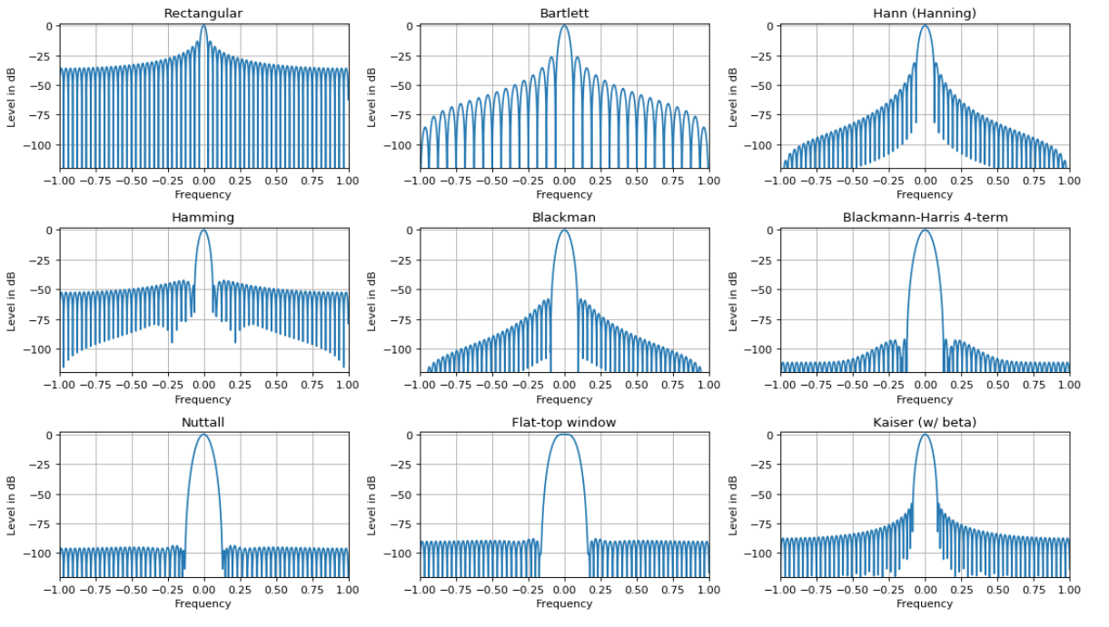
Windowing: most popular window functions

Slide 31
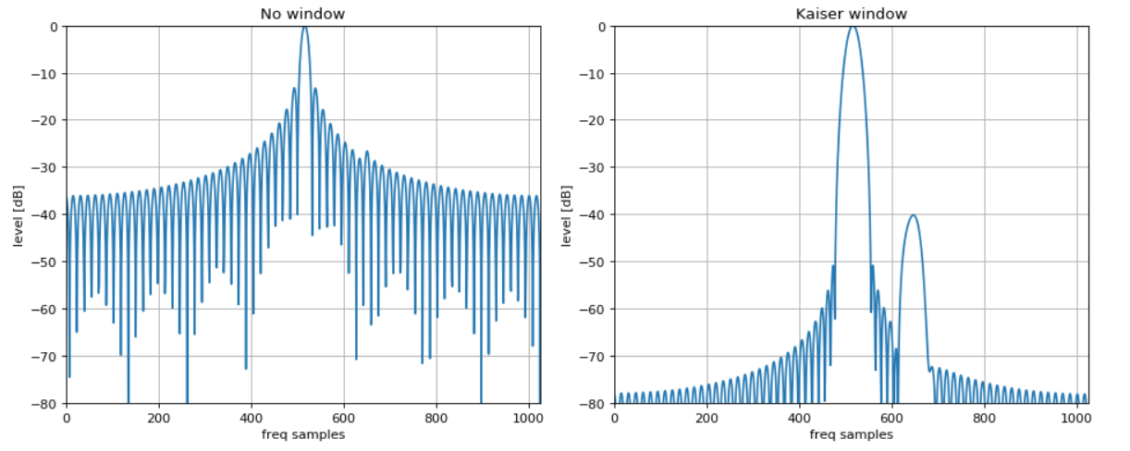
Windowing: most popular window functions
Search of weak signals:

